Slide 1
SELF-EMPATHY and WELLBEING
Life to the Full Wellbeing

Slide 2
Three circles of emotional regulation Paul Gilbert (2009)

Slide 3
All parts of us are inter - connected

Slide 5
The Threat can be real or perceived …

Slide 8
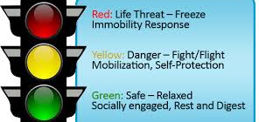
Taking a moment to go back into first gear …!
Latest Neuroscientific Research
champions the need for Self-Empathic connection
(Porges, Ventral Vagal Theory)

Slide 9
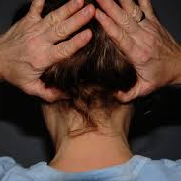
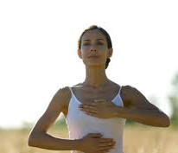

Slide 10
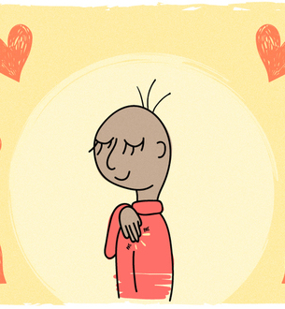
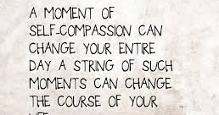
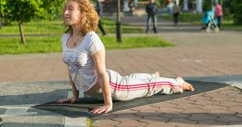
What’s your act of kindness to YOU today …?

Slide 11
When I listen to me, I can then listen to you !

